Slide 1
BREAULT SWD TRAINING
Date: Sept 16th, 2024
Attendance: John chu, tom Brixey, jon Herlocker, and pam james
Goal: Explain how to in’s and out’s of github in breaultswd org.

Slide 2
Github navigation
Briefly before we navigated through GITHUB. This serves as a refresher.
Repository: broken out into manageable sized container of code
Project: tracks current and future development
Teams: contains their own projects and links to repos
Inside Repos the menu changes to the one above
Code is the collection of code in each branch of the repo
Issue are associated tasks for the development team to work on (should only be in DEV_ repo)
Pull request are changes to the codespace from a fork of a development branch
Actions: are workflows set on users to preform a task. Not currently being used
Projects: can be repo specific, yet as an organization we are using org projects for better tracking
Wiki: Is documentation and roadmap for the software in the space. Not currently being used
Insights: Are statistics linked to the repo which shows all the changes made
Settings: Shall only be used by admin. This sets rules for the repo.

Slide 3
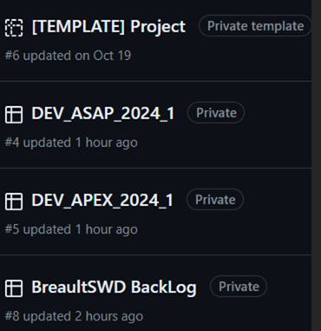
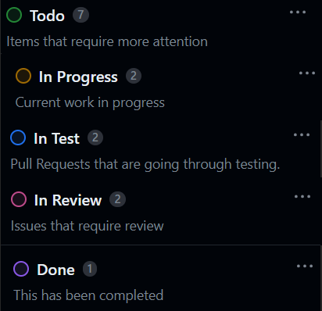
Projects
Tracks development efforts. All Issues and Pull Requests shall be assigned to a Project

Slide 4
Repository
Only the DEV_ repo’s shall have Issues associated.
No development shall be done directly on the BreaultSWD repo’s
All development shall be on forks
All test cases shall be in associated Test_Repo

Slide 5
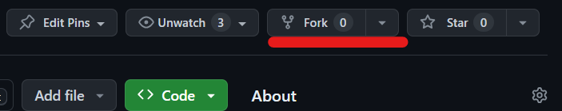
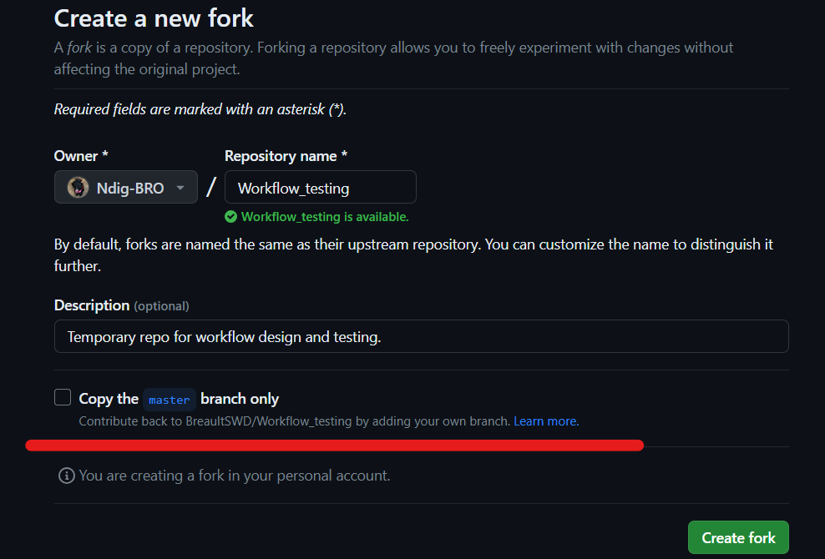
Creating a new fork
Select fork in the given repo
De-select Copy the branch only
Create fork
NOTE: if the fork or the repo does not
Have a DEV_ branch before the branch
Is created. This can be done after
If the developer has an existing fork
Creating a branch and syncing can be
Done.

Slide 6
Issues
Shall be from the back-log > moved to Current Development
Shall be associated to a DEV_ project
Shall be created on a DEV_ branch
Developer shall not close out issue without review
The reviewer shall close out the issue
Development shall be linked with a pull-request

Slide 7
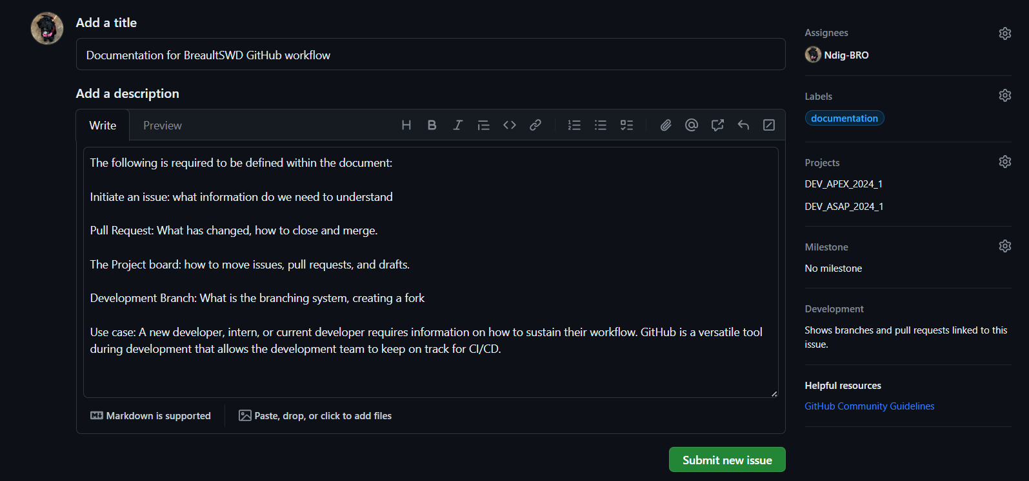
Issues
Most Issues are created as a draft in the Back-log. If the Issue is assigned to a DEV_ repo then it gets assigned.
A Label is not required. Project is required to be assigned. Should have Back-log if from a draft.
Description has all required information before the Issue has been researched.

Slide 8


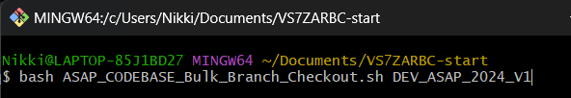

Obtaining the codebase bash files
Bash repo_clone first
Bash bulk_branch <DEV_ branch>
NOTE: this pulls from BreaultSWD and does not create a link to upload to GITHUB.

Slide 9
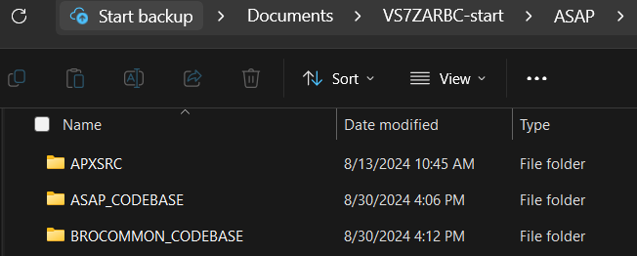
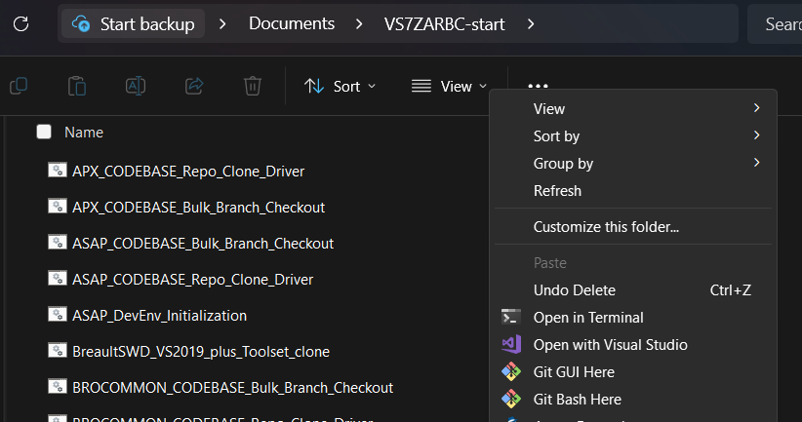
Bash scripts to call for new development
Delete the files within and keep the main folders
From VS7ZARBC call a git bash here

Slide 10
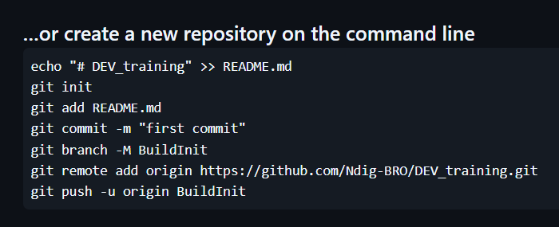
Commits in bash
git init -b <name of the local branch>
Git checkout -b <name of branch>
Add the files to your current local Branch:
git add .
git commit -m “<DEV_note>”
git remote add <name> <URL fork link>
git push <remote> <branch>

Slide 11
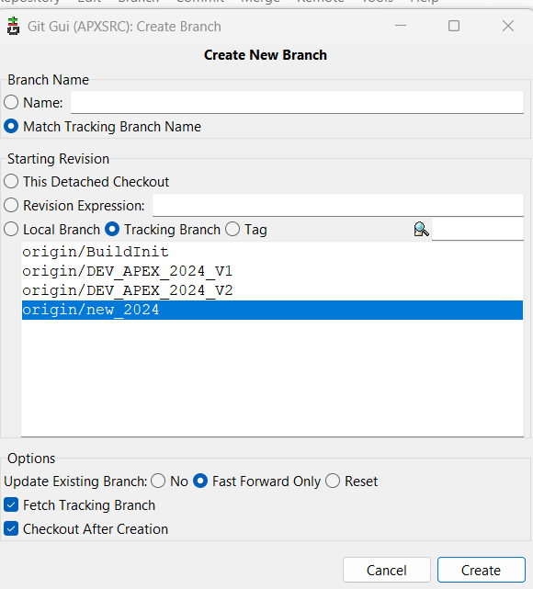
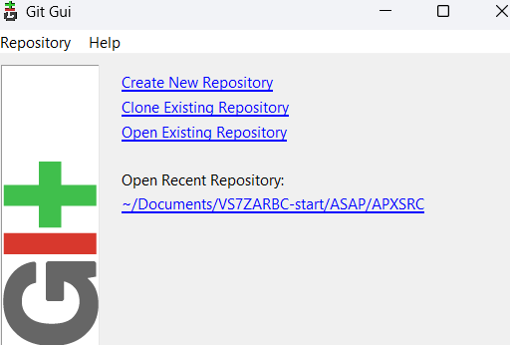
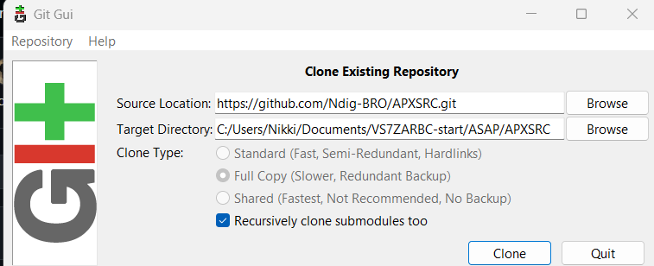
Cloning in git gui
NOTE: The last /APXSRC folder cannot exist in clone

Slide 12
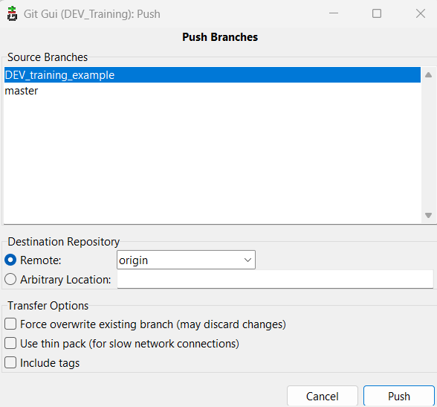
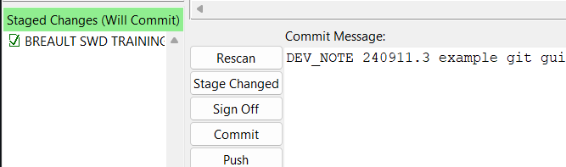
Commits in git gui
Select Rescan
Select Stage Changes
Add a commit message
Commit
Push – this will submit changes to GITHUB

Slide 13
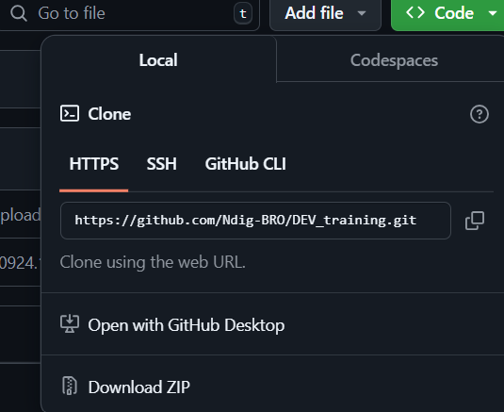
Zip download from github
From the <> Code tab the dev can obtain the git url
Dev team is not currently using GitHub Desktop.
Download zip is easiest to use on the one off obtaining
Files. The problem with getting the whole codespace
Causes a failure loading symbols in the IDE from a
Microsoft security issue. This can be fixed by going
In the file explorer to those files and changing the
Security settings.

Slide 14
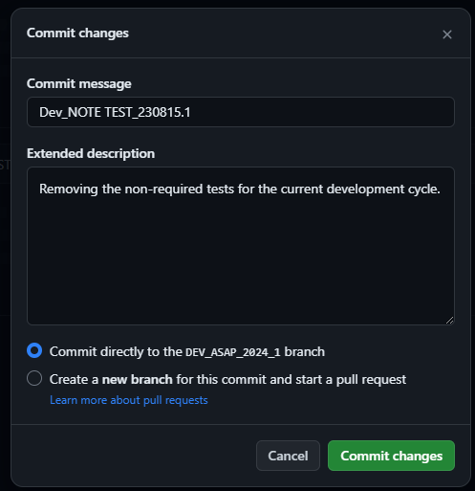
Commits in github

Slide 15
Pull-request (Development)
Shall be from personal fork to DEV_ branch
Shall never be into BuildInit (should be able to change in edit)
Shall be linked under development in the issue
Can be preformed in git bash, yet shall be within GITHUB
Shall be reviewed by another developer
Reviewer shall merge
If force merge, requires two verifications prior to merge
All requested alterations, commented on code, shall be preformed by author developer, not reviewer (even if simple)

Slide 16
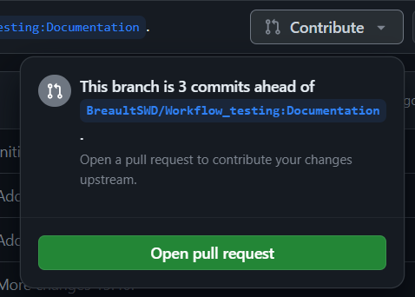
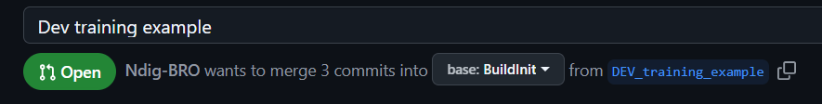
Pull-Request in GITHUB
Select Contribute: Open the Pull Request
The display should show if the code can merge.
Input information about what is completed in the pull-request
If the pull-request requires alteration to a different branch, select edit and select the drop-down

Slide 17
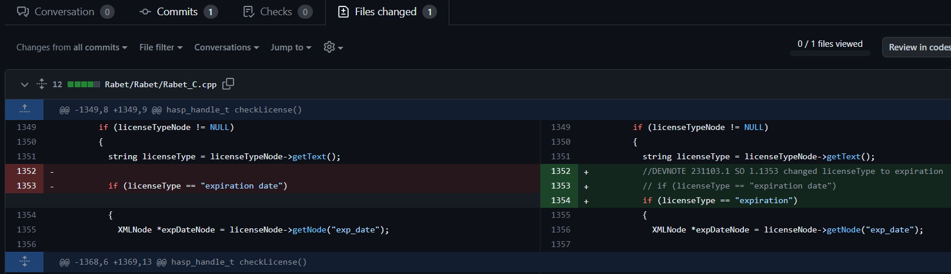
File change in pull-request
Each change made in the codebase is shown under the files changed tab.
Reviewers can add comments in the code locations
Developer can alter the codebase while the pull-request is still active and the changes will update the files changed

